Slide 1
Generative Adversarial Networks for Time Series
Autonomous Multisensor Systems Group
Institute for Intelligent Cooperating Systems
Faculty of Computer Science
Otto von Guericke University, Magdeburg
10.07.2024
Team Members: Archana Yadav, Gowtham Premkumar, Shweta Bambal

Slide 2
Contents
Introduction
Transformer based GAN
TimeGAN
WGAN
Way Forward
References

Slide 3
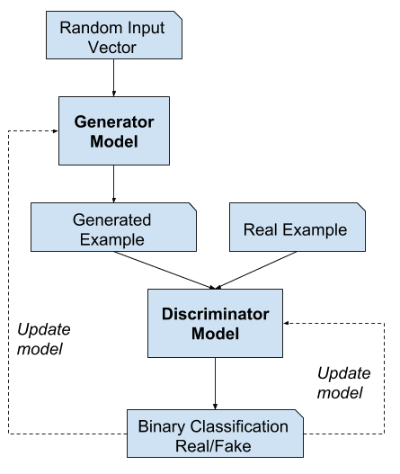
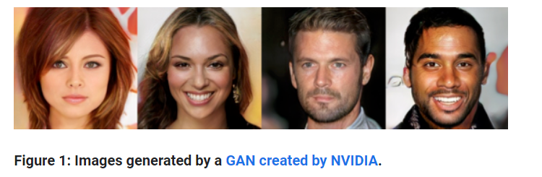
Introduction
Generative Adversarial Networks (GANs) are made up of two neural networks, a discriminator and a generator. They use adversarial training to produce artificial data that is identical to actual data.
https://machinelearningmastery.com/what-are-generative-adversarial-networks-gans/

Slide 4
Transformer GAN for Time Series
Transformers initially designed to handle long sequential data without vanishing gradient problem.
Consequently, Transformer GAN models are theoretically superior to RNN-based models for time-series data.
A leading model in deep learning, outperforming CNNs for images and RNNs for sequential data, due to its self-attention layers
Enhances synthetic data quality, improve training efficiency, especially in image and text generation.

Slide 5
Transformer GAN - Advantages
Advantages | Description
Long-range dependencies | Better captures complex temporal patterns and relationships over long sequences
Scalability | Scales well to handle larger datasets and longer sequences
Attention mechanism | Focuses on relevant parts of input for more coherent outputs
Parallel processing | Can process input sequences in parallel, improving efficiency
Performance | Consistently outperforms existing methods in generating high-quality synthetic data

Slide 6
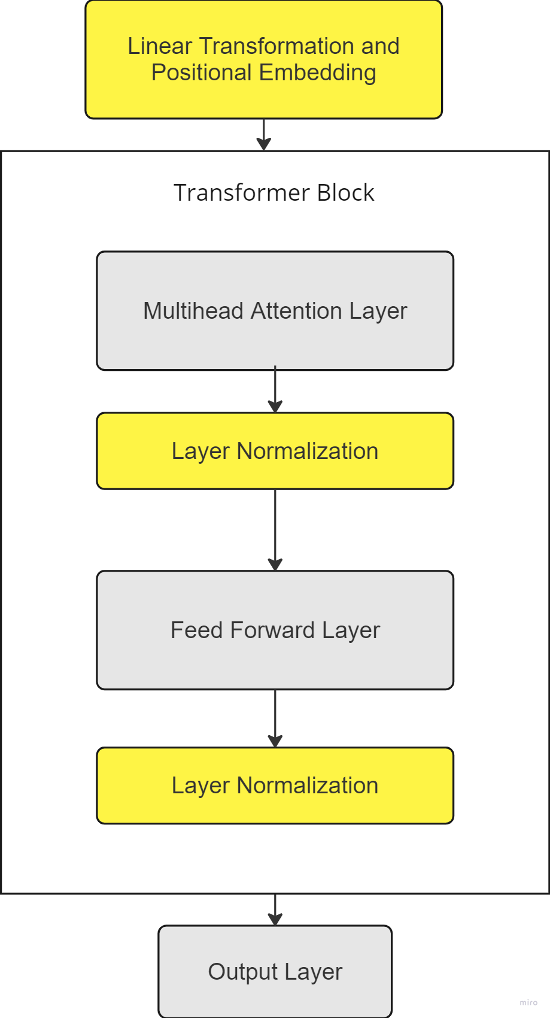
Transformer GAN - Model Architecture
https://arxiv.org/abs/2202.02691

Slide 7
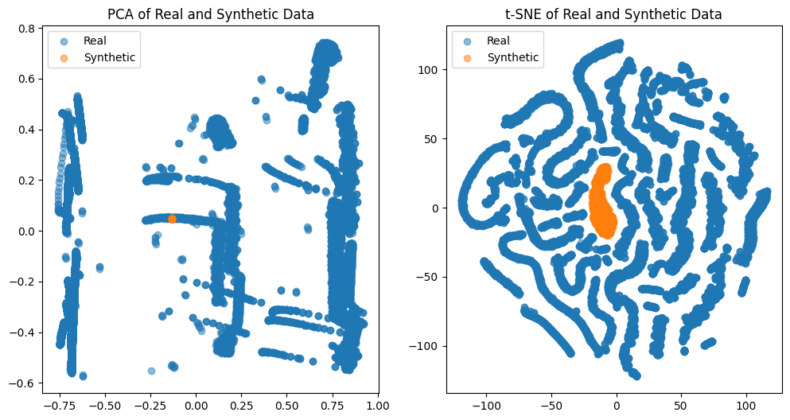
Transformer GAN - Evaluation Results
Fig : Results for 1000 iterations

Slide 8
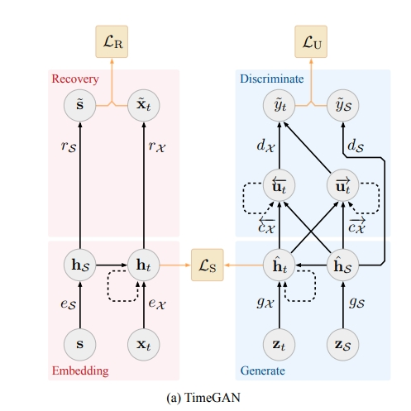
TimeGAN
Embedder
Maps the original high-dimensional feature space to a lower-dimensional latent space.
Synthetic Data
Discriminator
Recovery
Distinguishes between real and synthetic time-series data.
Maps the latent representations back to the original feature space.
Supervisor
Generator
Generates the next sequence in the latent space from the previous sequence.
Generates latent space representations from random noise.

Slide 9
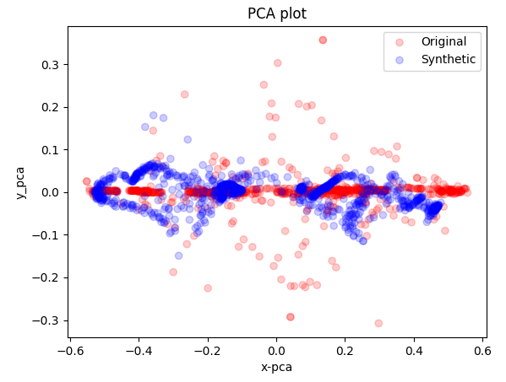
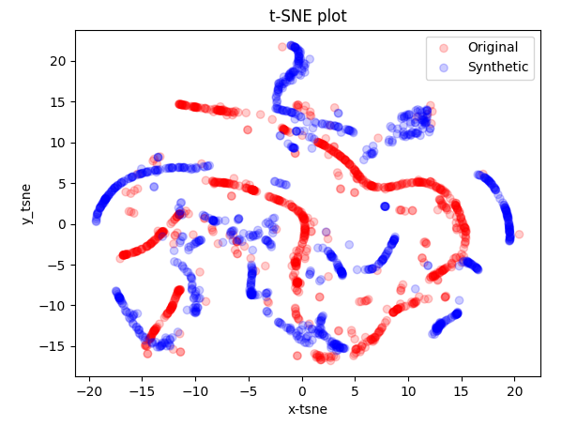
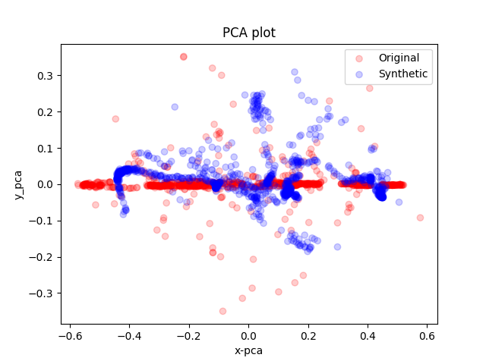
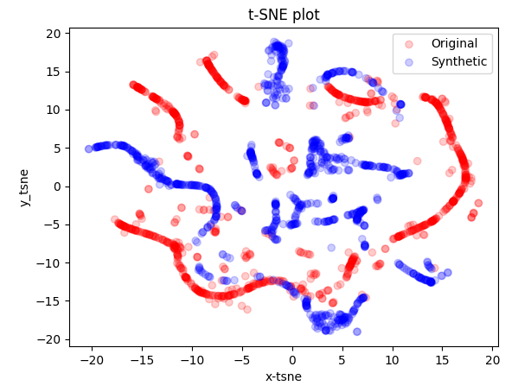
TimeGAN - Results for LSTM
Results for 10k Iterations
Results for 50k Iterations

Slide 10
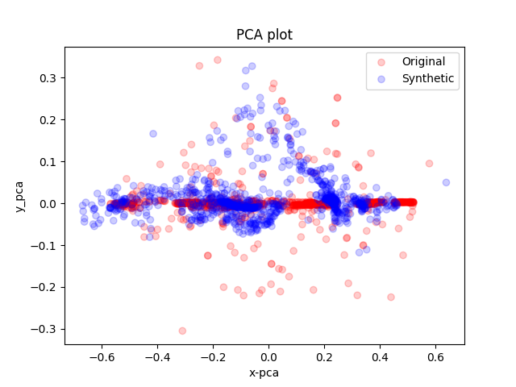
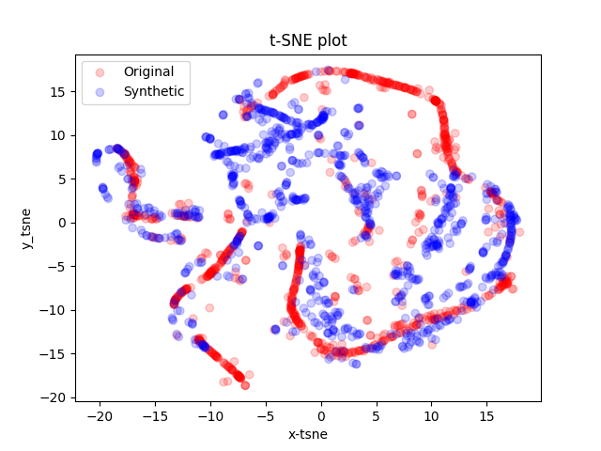
TimeGAN - Results for GRU
Results for 10k Iterations

Slide 11
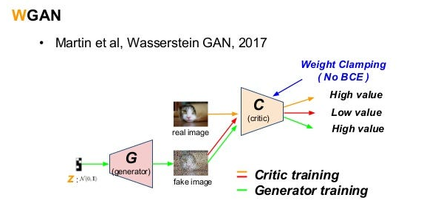
Wasserstein GAN (WGAN)
Generative Adversarial Networks (GANs): A deep learning framework with two neural networks:
Generator: Learns to create new data instances that resemble the real data.
Critic : Tries to distinguish between real and generated data the can be any real number rather than [0,1]
Loss Function: Wasserstein loss, which measures the Earth-Mover distance between real and generated data distributions, providing better gradients for training the generator.
Time Series Application:
Trains on existing time series data.
Generator creates new time series that capture the statistical properties of the real data.

Slide 12
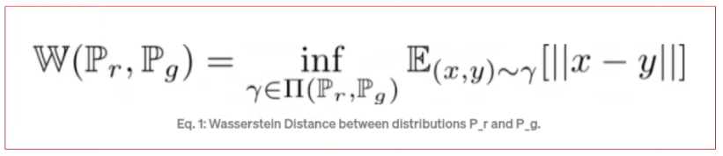
WGAN
Wasserstein Distance: Also known as the Earth-Mover distance, it measures the cost of transporting mass to transform one probability distribution into another.
Stable Training:
Reduced mode collapse and vanishing gradients ensure coherent sequence generation.
Suitable for capturing long-term dependencies in time series data.
Flexibility:
Suitable for both univariate and multivariate time series data.
High-Dimensional Data:
Effective in generating realistic high-dimensional time series data.

Slide 13
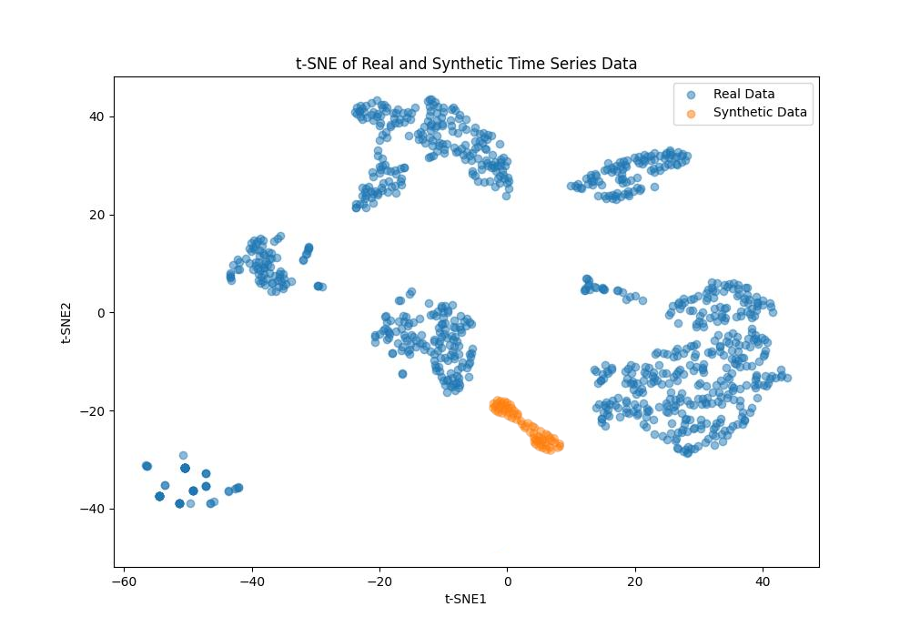
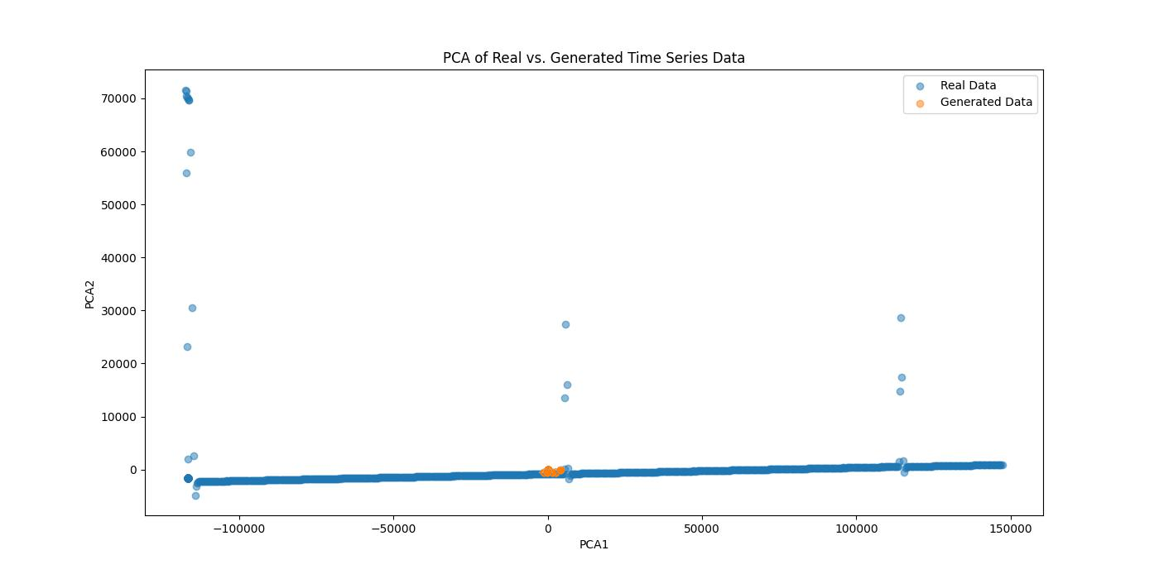
WGAN - Results

Slide 14
Way Forward
Fine tuning the hyperparameters to generate better results for the given dataset.
Identify advanced evaluation metrics specifically designed for GAN-generated time-series data and use them to assess the quality and realism of the generated time-series data.
Develop simple and clear visualizations to compare the real and generated time-series data.

Slide 15
References
https://www.geeksforgeeks.org/generative-adversarial-network-gan/
Xiaomin Li, Vangelis Metsis, Huangyingrui Wang, Anne Hee Hiong Ngu. (2022) TTS-GAN: A Transformer-based Time-Series Generative Adversarial Network. https://arxiv.org/abs/2202.02691
Yoon, Jinsung & Jarrett, Daniel & Schaar, Mihaela. (2019). Time-series Generative Adversarial Networks. https://www.researchgate.net/publication/344464212_Time-series_Generative_Adversarial_Networks
Padmanaba Srinivasan, William J. Knottenbelt. (2022) Time-series Transformer Generative Adversarial Networks https://arxiv.org/abs/2205.11164
https://www.techtarget.com/searchenterpriseai/tip/GAN-vs-transformer-models-Comparing-architectures-and-uses
https://blog.seduca.ai/id/57363/

Slide 16
Generative Adversarial Networks for Time Series
Thank You For Your Attention!

